Slide 1

WHO AM I AND WHY DO I HAVE A RIGHT TO TEACH THIS SEMINAR?
MASTER FINANCIAL COACH
LICENSED INSURANCE AGENT IN 9 STATES
RETIRED SCHOOL SUPERINTENDENT
RETIRED PASTOR
INSTRUCTOR WITH THE COUNCIL OF FINANCIAL EDUCATORS
RETIREMENT PLANNING SPECIALIST WITH ALTO FINANCIAL GROUP
I AM CALLED BY GOD TO HELP PEOPLE.
The Why- We are headed for turbulence. In fact, we are in turbulence. How can we make the flight smoother?

Slide 2

FINANCIAL WELLBEING
Financial well-being is a state of being wherein a person can fully meet current and ongoing financial obligations, can feel secure in their financial future, and is able to make choices that allow them to enjoy life – Consumer Protection

Slide 3
WHAT’S IN THIS PRESENTATION?
WHAT ‘S HAPPENING?
PRINCIPLES OF FINANCIAL WELLBEING
INTRODUCTORY STEPS TO A SECURE RETIREMENT
AN OPPORTUNITY TO SCHEDULE A NO COST APPOINTMENT TO DISCUSS INDIVIDUAL NEEDS.
GENERAL THOUGHTS ON FINANCIAL WELL-BEING

Slide 4

WHAT IS HAPPENING?
THINGS THAT CANNOT BE DISREGARDED

Slide 5
NATIONAL STATISTICS
National debt is growing astronomically.
12/20/2021- $29,040,968,263,701
08/30/2023 - $32,821,323,200,001
Debt Per American - $96,451
During President Trump’s term, the debt rose 7.8 trillion.
National Debt increase since the start of 2020 – 7 trillion
National Debt Interest – 2.4% GDP
Social Security – 23.7% GDP
Medicare – 3.9% GDP
THIS MEANS THAT A TAX INCREASE IS ON THE HORIZON!
1 trillion seconds equals 31,709.8 years

Slide 6
INDIVIDUAL AND HOUSEHOLD STATISTICS
Average American owes $59,580
Total consumer debt in America - $17 Trillion
Average Household debt $101,915
Mortgage Debt - $12.04 Trillion
44 million Americans owe $1,745,000,000,000 in student loans.
Americans had credit card debt of $893,000,000,000 in April 2023
Credit Card Debt hit 1.03 trillion in the second quarter of 2023
$100 in 1967 is equivalent in purchasing power to about $908.27 today, an increase of $808.27 over 56 years.
In 1968, the average minimum wage worker earned $10.59 per hour in inflation-adjusted terms, which is 46% more than what workers earn today.

Slide 7
2021 to 2023
Notice what happened to prices from 2021 to now.
$1 in 2021 has purchasing power of $1.13 today.
Groceries – up 10.4%
Gasoline – up 41.5%
Used cars – up 40.5%
Housing – up 20.6%
Overall cost of living – up 5.8% (8.7% in 2022)

Slide 8
VERY GRIM STATISTICS
48% OF OLDER HOUSEHOLDS HAVE NO RETIREMENT SAVINGS
43% of retirees reported they were afraid their monthly benefit would fall in the future.
49% of people nearing retirement cite running out of money as their chief retirement concern.
77% of seniors reported being concerned that rising healthcare costs will result in significant and lasting damage to the economy.
62% of savers aged 45 and over said they're worried about the impact of market volatility on their retirement income.
9 in 10 adults say they are at least somewhat concerned about inflation

Slide 9
STATISTICAL FACTS
2023 COLA for SS = 8.7%
New Tax Code is coming – 1/2026
$100,000 in 1967 is equivalent in purchasing power to about $902,118.54 today, a cumulative price increase of over 800%.
College tuition costs has risen 69% since 2000.
401 (k) plan participants have lost about $1.4 trillion from their accounts since the end of 2021.
Average Credit Card APR – 24.59%
If a person has $5000 in Credit Card debt and only pays the minimum payment each month, it could take over 30 years to pay the debt.

Slide 10
WHAT DOES ALL THIS MEAN?
AMERICANS ARE WORRIED ABOUT THE PRESENT AND THE FUTURE
Americans are likely facing a substantial tax increase in 2026
AMERICAN FAMILIES ARE STRUGGLING TO MAKE ENDS MEET
THE AMERICAN ECONOMY IS VERY UNSTABLE
SOME AMERICANS NEED A MEANS OF CONQUERING CREDIT CARD DEBT
Many American students are starting their work careers with huge debt
American families need a means of helping their children avoid huge college debt
Americans must change some of the things they are practicing
Americans preparing for retirement need some new vehicles for investment with less risk

Slide 11

PRINCIPLES OF FINANCE
THERE ARE A NUMBER OF AGE-OLD PRINCIPLES OF FINANCE THAT ARE CONTINUALLY VIOLATED IN THE 21ST CENTURY!

Slide 12
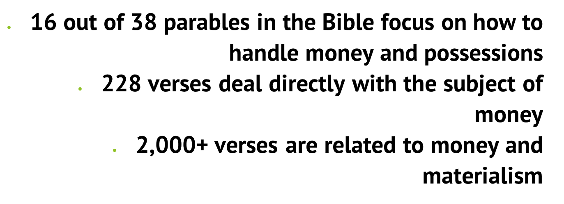
PRINCIPLES OF FINANCE

Slide 13
FIVE BIBLICAL PARABLES DEALING WITH MONEY
THE UNFORGIVING DEBTOR
MATTHEW 18:23-35
LABORERS IN THE VINEYARD
MATTHEW 20:1-16
THE TALENTS
MATTHEW 25:14-30
THE RICH FOOL
LUKE 12:13-21
RICH YOUNG RULER
MATTHEW 19:16-22

Slide 14
FIVE BIBLICAL PRINCIPLES DEALING WITH MONEY
GOD ALLOWS US TO GET WEALTH
DEUTERONOMY 8:18
BUDGET WISELY
Luke 14:28-30
GIVE AND IT WILL BE GIVEN TO YOU
Luke 6:38
SAVE WHILE THERE IS TIME
Prov. 30:24-25
AVOID DEBT
Prov. 22:7

Slide 15
BIBLICAL PRINCIPLES SCRIPTURES
But thou shalt remember the Lord thy God: for it is HE that giveth thee power to get wealth, that he may establish his covenant which he sware unto thy fathers, as it is this day. Deuteronomy 8:18
For which of you, intending to build a tower, sitteth not down first, and counteth the cost, whether he have sufficient to finish it? Luke 14:28
Give, and it shall be given unto you; good measure, pressed down, and shaken together, and running over, shall men give into your bosom. For with the same measure that ye mete withal it shall be measured to you again. Luke 6:38
Four things on earth are small, yet they are extremely wise: Ants are creatures of little strength, yet they store up their food in the summer. Proverbs 30:24-25
The rich ruleth over the poor, and the borrower is servant to the lender. Proverbs 22:7

Slide 16
FIVE MORE BIBLICAL PRINCIPLES DEALING WITH MONEY
WORK HARD
Prov. 14:23
DON’T LOVE MONEY
I Tim. 6:10-11
BE CONTENT WITH WHAT YOU HAVE
Phil. 4:11-12
DON’T WORRY ABOUT MONEY
Mt. 6:25-27
TRUST GOD TO PROVIDE
Phil. 4:19

Slide 17
WHAT THE SCRIPTURES SAY!
In all labour there is profit: but the talk of the lips tendeth only to penury. Proverbs 14:23
For the love of money is the root of all evil: which while some coveted after, they have erred from the faith, and pierced themselves through with many sorrows. I Timothy 6:10
Let your conversation be without covetousness; and be content with such things as ye have: for he hath said, I will never leave thee, nor forsake thee. Hebrews 13:5
Which of you by taking thought can add one cubit unto his stature? Matthew 6:27
But my God shall supply all your need according to his riches in glory by Christ Jesus. Philippians 4:19

Slide 18
PRACTICAL SOLUTIONS BASED ON BIBLICAL PRINCIPLES
THINGS WORTH REMEMBERING

Slide 19
SIX PRINCIPLES OF FINANCE
LEARN WHAT YOU CAN ABOUT MONEY
YOU HAVE THE ABILITY TO GAIN WEALTH
PLAN FOR EMERGENCIES
AVOID DEBT WHENEVER POSSIBLE
SAVE FOR RETIREMENT
SPEND LESS THAN YOU EARN

Slide 20
LEARN WHAT YOU CAN ABOUT MONEY
THE MONEY YOU MAKE MATTERS; THE MONEY YOU SAVE MATTERS MORE.
TIME IS MORE IMPORTANT THAN MONEY
BE AWARE OF WHERE YOUR MONEY GOES
FOCUS MORE ON VALUE CREATION THAN PENNY PINCHING
GET RICH QUICK SCHEMES HAVE MORE RISK
LET YOUR MONEY WORK FOR YOU
YOU ARE YOUR MOST IMPORTANT ASSET
KEEP LEARNING

Slide 21
YOU HAVE THE ABILITY TO GAIN WEALTH
CREATE A VISION AND PURPOSE
DEVELOP THE RIGHT MINDSET AND HABITS
KNOW WHERE YOU ARE STARTING FROM
MASTER MONEY MANAGEMENT
SET FINANCIAL GOALS
CHOOSE THE RIGHT VEHICLE FOR INVESTING
MASTER THAT VEHICLE
WORK TOWARD FINANCIAL FREEDOM
OPTIMIZE YOUR TAXES

Slide 22
PLAN FOR EMERGENCIES
DEVELOP A RAINY-DAY FUND
HAVE THREE TO SIX MONTHS OF EXPENSES IN IT
DON’T KEEP TOO MUCH MONEY IN THE FUND
DON’T USE THE RAINY-DAY FUND FOR EVERYDAY
HAVE THE MONEY ACCESSIBLE BUT AT THE BEST INTEREST RATE POSSIBLE
PLAN FOR ROUTINE COSTS
PERFORM AN INSURANCE AUDIT
KNOW WHAT YOU CAN CUT
STOP IMPULSE BUYING

Slide 23
AVOID DEBT WHENEVER POSSIBLE
The borrower becomes a slave to the lender
Less debt provides more free income
Less debt means less risk of disaster during emergencies
Less debt means a higher credit score
Less debt means less stress
Less debt leads to a higher self esteem
Less debt leads to better health
Less debt leads to better relationships
Less debt lets you give more and help others

Slide 24
SPEND LESS THAN YOU EARN
LIVE AS DEBT FREE AS POSSIBLE
GIVES YOU THE ABILITY TO BUILD WEALTH
YOU HAVE LESS STRESS AND ANXIETY
YOU HAVE MORE FINANCIAL CONFIDENCE
YOU GAIN MORE FREEDOM
YOU FEEL FINANCIALLY SECURE
YOU FIND CONTENTMENT
YOU HAVE A HEALTHIER LIFESTYLE
YOU FIND THAT GIVING IS POSSIBLE

Slide 25
SAVE FOR RETIREMENT
BEGIN EARLY TO SAVE FOR RETIREMENT
SOCIAL SECURITY WON’T BE ENOUGH (ABOUT 40%)
WE ARE LIVING LONGER
RETIREMENT SAVINGS BELONG TO YOU
RETIREMENT LIFESTYLE CAN BE BETTER
TIME WORKS FOR YOU
YOU MAY NOT BE ABLE TO SAVE LATER
WORKING DURING RETIREMENT WILL BE A CHOICE
YOU WON’T BE A BURDEN TO YOUR FAMILY

Slide 26
SIX MORE PRINCIPLES OF FINANCE DEALING WITH MONEY
BUILD YOUR CREDIT SCORE
DON’T FALL IN LOVE WITH MONEY
LEARN TO BE CONTENT WITH WHAT YOU HAVE
DON’T WORRY ABOUT THE WHAT IFS
BUY JUST THE RIGHT AMOUNT OF INSURANCE
GIVE AND IT WILL BE GIVEN

Slide 27
BUILD YOUR CREDIT SCORE
SOUNDS CONTRADICTORY, BUT YOU DON’T HAVE TO USE IT BECAUSE YOU HAVE IT
SAVES ON INTEREST WHEN YOU DO BORROW
LOWERS CAR INSURANCE PREMIUMS
EASIER TO BUY A CAR OR HOUSE
EASIER TO RENT AN APARTMENT
HELPS ON EMPLOYMENT BACKFROUND CHECKS
HELPS ON SECURITY CLEARANCES

Slide 28
DON’T FALL IN LOVE WITH MONEY
It tempts: Loving money makes us do wrong things AND FOOLISH THINGS in order to get more of it.
It traps: The love of money gets a grip on us, it won’t let go, and becomes AN obsession.
It stimulates lust: It produces multiple other desires and provides opportunity for their fulfillment.
It harms: The lusts themselves injure the luster, and what they result in does even more harm.
It destroys RIGHT THINKING: It sucks INTO A THOUGHT PROCESS WHERE IT IS THE MOST IMPORTANT THING.
It diverts: IT DRIVES YOU FROM TRUE AMBITION INTO SEEKING MONEY MORE THAN ANYTHING ELSE.
It depresses: Money love produces soul pain and soul sadness BECAUSE IT IS ALL YOU THINK ABOUT.
It ends: MONEY IS NEVER SAFE BECAUSE ONE WRONG DECISION OR WRONG TURN CAN ROB YOU.

Slide 29
LEARN TO BE CONTENT WITH WHAT YOU HAVE
Contentment means to be happy with what you have, who you are, and where you are. Contentment is not based on the money in your bank account. Contentment is not having what you want. It is wanting what you have.
BRINGS PEACE OF MIND
BRINGS SELF ACCEPTANCE
STOPS COMPARISON WITH THE JONES FAMILY
ALLOWS YOU TO KNOW YOUR NEEDS FROM YOUR WANTS
HELPS BUILD STRONGER AND HEALTIER RELATIONSHIPS
A STEP TO REALIZING YOUR PURPOSE IN LIFE
REDUCES THE FEAR OF FAILURE
OPEN THE DOOR TO SUCCESS
But godliness with contentment is great gain. ⁷ For we brought nothing into this world, and it is certain we can carry nothing out. ⁸ And having food and raiment let us be therewith content.

Slide 30
DON’T WORRY ABOUT THE WHAT IF’S
“If it doesn’t stop raining, I don’t know what we will do.” “If it doesn’t rain, I don’t know what we will do.”
THERE IS NO TIME LIKE THE PRESENT
THE WORLD CHANGES CONTINUALLY
WE CHANGE CONTINUALLY
YOU CAN’T CHANGE ANYTHING BY WORRYING
LIFE IS FULL OF SURPRISES AND CHALLENGES
NO ONE KNOWS WHAT TOMORROW HOLDS
WORRY IS JUST MORE STRESS AND LESS SLEEP

Slide 31
BUY THE RIGHT AMOUNT OF INSURANCE
IF SOMEONE PASSES IN A TWO INCOME FAMILY, ONE INCOME IS GONE.
IF SOMEONE PASSES, DEBTS STILL MUST BE PAID.
IF SOMEONE PASSES, END OF LIFE EXPENSES MUST BE COVERED.
INSURANCE CAN BE USED TO PAY FOR EDUCATION.
WOULD YOU LIKE TO LEAVE A LEGACY?
BUSINESS OWNERS WANT THE BUSINESS TO CONTINUE.
LIVING BENEFITS CAN BE USED IN EMERGENCIES AND UNPLANNED ILLNESSES.
INSURANCE CAN PROVIDE PEACE OF MIND.
DON’T BECOME INSURANCE POOR.

Slide 32
GIVE AND IT WILL BE GIVEN
This comes from the Bible and is often misinterpreted. The Bible does not teach us to give in order to get. The passage says that people who give get. It doesn’t even specify that it is discussing giving and getting money. However, there are some reasons to give.
Giving makes the giver feel good. Giving is a mood booster.
Giving strengthens personal values.
Giving is more impactful than ever before.
Giving produces generosity in others.
Giving can impact a community.
Giving sets an example to others.
Giving can provide tax benefits.
Giving supports those who give themselves.

Slide 33
SIX MORE PRINCIPLES OF FINANCE EALING WITH
INCREASE YOUR SAVING RATE SYTEMATICALLY
PLAN FOR WHAT YOU BUY
LEARN THE BASICS OF INVESTING
UNDERSTAND THE TIME VALUE OF MONEY
LEARN HOW CREDIT CARDS AND INTEREST WORKS
BALANCE YOUR CHECKBOOK

Slide 34
INCREASE YOUR SAVING RATE SYSTEMATICALLY
THE YOUNGER YOU START SAVING THE BETTER
SAVING MONEY LEADS TO FINANCIAL INDEPENDENCE
A PENNY SAVED IS A PENNY EARNED
MONEY SAVED CAN GROW IF PLACED IN THE RIGHT VEHICLE
THE MORE YOU PAY DOWN ON A HOME THE LESS THE LOAN CAN COST (PMI)
PAYING CASH SAVES INTEREST
SAVING LETS YOU BE PREPARED FOR UNFORESEEN EXPENSES
TEACHING YOUR CHILDREN TO SAVE TRAINS THEM

Slide 35
PLAN FOR WHAT YOU BUY
ONE OF THE GREATEST CAUSES OF DEBT IS IMPULSE BUYING
ASK SOME QUESTIONS
DOES THIS ITEM HAVE A PURPOSE?
HOW LONG WILL THIS ITEM LAST?
HOW MUCH WILL WE USE THIS ITEM?
Will this item just cause clutter later?
AM I WANTING THIS BECAUSE MY FRIEND HAS ONE?
IS THERE A BETTER OPTION THAN BUYING THIS?
COULD I WAIT AND PAY CASH FOR THIS?
HAVE I CONSIDERED ALL MY OPTIONS?
49 PAIRS OF PANTS

Slide 36
LEARN THE BASICS OF INVESTING
Bull market.
Bear market.
Dividend.
Mutual fund.
Asset.
Broker.
Diversity.
RISK
SAFE MONEY
fees
IRA
ROTH IRA
401K
403B
index
PARTICIPATION RATE
Point to point
CAP
S&P 500
DOW JONES
NASDAQ
IUL
WHOLE LIFE
TERM LIFE
ILLUSTRATION
FEE
Pre-taxed
Post-taxed
Sequencing of returns risk

Slide 37
UNDERSTAND THE TIME VALUE OF MONEY
The time value of money (TVM) is the concept that a sum of money is worth more now than the same sum will be at a future date due to its earnings potential in the interim.
The time value of money is a core principle of finance.
A sum of money in the hand has greater value than the same sum to be paid in the future.
Inflation has a negative impact on the time value of money because your purchasing power decreases as prices rise.
The formula for computing the time value of money considers the amount of money, its future value, the amount it can earn, and the time frame.

Slide 38
LEARN HOW CREDIT CARDS AND INTEREST RATE WORK
CREDIT CARD INTEREST IS THE FEE YOU’RE CHARGED FOR BORROWING MONEY WITH YOUR CREDIT CARD.
The average credit card interest in July 2023 was 23.99%.
THAT FEE IS BASED ON AN ANNUAL PERCENTAGE RATE, WHICH DEPENDS ON YOUR CREDIT PROFILE AND THE RISK INVOLVED. TO CALCULATE YOUR DAILY INTEREST RATE, YOU DIVIDE THE APR BY 365.
THE RATE IS APPLIED TO YOUR CURRENT BALANCE AND ANY NEW PURCHASES THAT POST TO YOUR ACCOUNT.
If the balance is not paid in full by the end of the billing cycle, the interest will compound daily, meaning that you will pay interest on interest.
PAYING THE MINIMUM ON A CREDIT CARD BALANCE OF $5000 WILL TAKE 23 YEARS TO PAY THE BALANCE OFF.

Slide 39
BALANCE YOUR CHECKBOOK
Banks, thrifts and credit unions earned $32.5 billion in overdraft revenue last year.
THAT DOES NOT INCLUDE THE AMOUNT PAID TO THE BUSINESS WHERE THE RETURNED CHECK WAS RECEIVED.
Sometimes dipping into an overdraft is inevitable with online banking.
Ensure you check your balance regularly. Ensure you are not overspending on unnecessary items
Download your bank's app, as well as setting up mobile and online banking
Set up text alerts from when you drop to a certain amount to avoid the red completely
Set a budget to manage your own finances, check that you’re not dipping into an overdraft for your usual monthly outgoings, and try and make the required budget cuts.

Slide 40
SIX MORE PRINCIPLES OF FINANCE EALING WITH
MAKE A BUDGET AND LIVE WITHIN IT
LEARN TO SAY NO TO YOURSELF AND YOUR FAMILY
BE MODEST WHEN ESTIMATING YOUR RATE OF RETURN ON INVESTMENTS
MANAGE YOUR DEBT
MAXIMIZE EMPLOYEE BENEFITS
UNDERSTAND YOUR PAYCHECK

Slide 41
MAKE A BUDGET AND LIVE WITHIN IT
A budget is a financial spending plan that estimates income and expenses for a specific period. Without a budget, an individual or family may experience overspending.
HELPS WITH BeING prepared for emergencies
HELPS Set goals for the future
HELPS WITH MeetING financial goals for the future
HELPS WITH PayING off debt
MAKES preparing taxes EASIER
HELPS WITH Making large financial decisions
HELPS WITH Saving for retirement

Slide 42
LEARN TO SAY NO TO YOURSELF AND YOUR FAMILY
Don’t talk to salespeople unless you initiated the conversation.
Don’t take freebies from salespeople.
Clean and straighten your closet/cupboards/pantry before you go shopping.
Cut down on trips to the mall, the big box stores, or any other place where you spend money.
Shop online but buy only what you need. Don’t window shop online.
Make an unbreakable rule to never buy anything from solicitors at your front door or by phone.
Before buying something, consider how you’ll feel about this purchase in one month or one year.
Treat yourself without spending money.
Let a smart shopper mentor you.
Keep your eyes on your goals.

Slide 43
BE MODEST WHEN ESTIMATING YOUR RETURN ON INVESTMENTS
Since 1932, bear markets have occurred, on average, every 56 months (about four years and eight months), according to S&P Dow Jones Indices.
KNOW THE STATISTICS
5.75% average annual return
2.92% average for the worst 20-year period
10.98% average for the best 20-year period
UNDERSTAND THE POWER OF DOWNSIDE PROTECTION
KNOW THAT A 30% LOSS IN THE MARKET REQUIRES A 43% INCREASE TO GET YOUR INVESTMENT BACK TO WHERE IT WAS.

Slide 44
MANAGE YOUR DEBT
STOP MAKING DEBTS. PAY CASH FOR WHAT YOU NEED
MAKE A LIST OF WHAT YOU OWE AND THE PAYMENTS YOU ARE REQUIRED TO MAKE
SEPARATE THE UNSECURED DEBT LIKE CREDIT CARD DEBT AND STUDENT LOANS
PAY OFF THE HIGHEST INTEREST DEBT FIRST
APPLY THAT MONEY TO NEXT HIGHEST INSTEREST DEBT UNTIL IT IS PAID
BEGIN TO PAY MORE THAN THE MINIMUM
PAY EXTRA ON YOUR HOUSE AND CAR PRINCIPALS
BEGIN A SAVING ACCOUNT AS YOU HAVE MONEY
WHEN MONEY IS FREED UP, SAVE SYSTEMATICALLY.
IMMEDIATELY STOP IMPULSE BUYING

Slide 45
MAXIMIZE EMPLOYEE BENEFITS
Take time to investigate WHAT BENEFITS ARE OFFERED.
TAKE ADVANTAGE OF EMPLOYER MATCH PLANS
SEE IF THE EMPLOYER HAS A PLAN THAT CAN SAVE TAX MONEY.
REMEMBER THAT GROUP PLANS ARE OFTEN LESS EXPENSE
DROP THOSE PLANS YOU PAY FOR BUT ARE NOT UTILIZING
PARTICIPATE IN THE COMPANY WELLNESS PLAN
ASK QUESTIONS OF THE EMPLOYER

Slide 46
UNDERSTAND YOUR PAYCHECK
OFTEN PEOPLE HAVE DEDUCTIONS COMING OUT FOR THINGS THEY SIGNED UP FOR YEARS AGO AND FORGOT ABOUT.
Gross wages (the amount you earn before deductions)
Tax deductions (federal, state, and local taxes, Social Security, Medicare)
Other deductions (health insurance, life insurance, 401k)
Net pay (the amount of pay you "take home" after deductions)
LOOK AT THE DEDUCTIONS ON YOUR CHECK STUB
FIND OUT WHAT THOSE DEDUCTIONS ARE GETTING YOU
IF YOU ARE NOT UTILIZING WHAT THE DEDUCTION IS PROVIDING, CANCEL THE DEDUCTION

Slide 47
END OF SESSION ONE

Slide 48
PRACTICAL SOLUTIONS BASED ON RECOGNIZED PRINCIPLES
THINGS WORTH REMEMBERING

Slide 49
WHAT CONCERNS DO AMERICAN FAMILIES HAVE?
HIGH COST OF LIVING
COLLEGE EXPENSES
DEBT
UNEXPECTED EXPENSES
HEALTHCARE COSTS
RETIREMENT SAVINGS
EXTRA-
CURRICULAR COSTS
LACK OF SAVINGS
LOW PAY
CHILDCARE
LOSS OF A JOB
RECESSION POSSIBILITY

Slide 50
HIGH COST OF LIVING
MAKE A BUDGET AND LIVE WITHIN THE BUDGET
PAY OFF DEBT STARTING WITH CREDIT CARD DEBT
AVOID CREDIT CARD USE AS MUCH AS POSSIBLE AND PAY THE CREDIT CARD OFF EACH MONTH.
LOOK FOR SALES.
BECOME A COUPON SHOPPER.
PRAY BEFORE YOU BUY.
LEARN TO BE CONTENT.
DON’T MAKE A NEW DEBT TO PAY AN OLD DEBT.
“BEWARE OF LITTLE EXPENSES. A SMALL LEAK WILL SINK A GREAT SHIP.” – BEN FRANKLIN

Slide 51
MAKING A BUDGET
Below are some suggested budget percentages. However, inflation has made sticking to a budget very difficult.
Housing costs: 25% - risen 15% since 2021
Saving: 15%
Food: 12% - risen 10.4% since 2021
Childcare: 12% - risen 41% since the start of the pandemic
Giving: 10% - Honour the Lord with thy substance, and with the firstfruits of all thine increase: So shall thy barns be filled with plenty, and thy presses shall burst out with new wine. Proverbs 3:9-10
Insurance: 4% - Health 28.2%; car 19.5%; house 12.1% since 2021
Utilities: 4% - risen 54% since 2021
Personal spending: 4%
Lifestyle and entertainment: 4% - risen 22.7% since 2021
Transportation: 3% - risen 12.6% since 2021
Health: 2% - risen 6-12% since the pandemic started
Miscellaneous: 5%

Slide 52
DON’T LET DEBT DROWN YOU!
Owe no man any thing, but to love one another: for he that loveth another hath fulfilled the law. Romans 13:8
The rich ruleth over the poor, and the borrower is servant to the lender. Proverbs 22:7
Be not thou one of them that strike hands, or of them that are sureties for debts. Proverbs 22:26
IF YOUR OUTGO EXCEDES YOUR INCOME THEN YOUR UPKEEP WILL BECOME YOUR DOWNFALL.
Debt Reduction Strategies
Highest Interest Rate Method
Snowball Method
Organize Your Monthly Bills – list and due dates
Create You Debt Reduction Strategy
Take Control of Your Finances
Pay Bills When Due
Track You Spending
Stop Impulse Buying – Buy with Cash

Slide 53
GETTING RID OF CREDIT CARD DEBT!
The Average Credit Card Interest Rate was 23.99% during July of 2023. Forbes says it is 24.12%.
Charging on a Credit Card means you pay from one-fifth to one-fourth more for the item charged.
Paying the 2% Minimum Payment each month will take over 30 years and over $23,000 interest to pay the debt, if you charge no more.
REMEMBER THAT CREDIT CARD COMPANIES MAKE THEIR MONEY BY GETTING YOU TO USE YOUR CREDIT AND KEEPING YOU IN DEBT.
Find a payment strategy or two.
Pay more than minimum
Debt Snowball – smallest debt first
Debt Avalanche – highest interest rate first
Automate – put the payments on autopay to avoid late charges
Debt consolidation
Take out a personal loan to pay off debt
Get 0% card and transfer the debt to it.
Work with your creditors
Seek Debt Relief Program
Seek Debt Settlement

Slide 54
LET’S TALK ABOUT MORTGAGES!
A 15-20 MORTGAGE CAN SAVE OVER A 30 YEAR MORTGAGE.
20% DOWN WILL STOP PRIVATE MORTGAGE INSURANCE.
MORTGAGE PROTECTION INSURANCE PAYS THE MORTGAGE IF THE OWNER DIES.
0% MOVE-IN CAN BE COSTLY IN THE LONG RUN.
PAYING EXTRA ON THE PRINCIPAL EACH MONTH WILL ALLOW THE MORTGAGE TO BE PAID QUICKER.
REFI WITH CASH BACK EXTENDS THE LENGTH OF THE CONTRACT.
PAYING OVER LIST PRICE IS NOT A GOOD IDEA.

Slide 55

REDUCING CREDIT CARD DEBT
Remember that credit card companies desire to keep you in credit card debt. Paying the minimum does not get you out of debt.
Stop using credit cards.
Reduce the number of credit cards you have.
Transfer your credit card debt to a 0-interest card and begin to pay as much as possible each month.
Get help from Debt Reduction Company.

Slide 56
LET’S TALK ABOUT CAR LOANS!
Car depreciation over the first 12 months from new CAR will typically be between 30-40% of the initial value.
A 5-year-old vehicle that sold for $40,000 when new will be worth $16,000 AND LIKELY YOU WOULD BE MAKING $600 PER MONTH PAYMENTS.
On average, a used car will already have lost 20% to 30% of its value in its first year and 50% OF its value by year three or four.

Slide 57
HOW CAN YOU SEND YOUR CHILDREN TO COLLEGE?
The average cost of a year of college was $19,020 in 2020-21.
Student Loan Debt is at an all time high. $30,000+ is average.
Student Loan debt in America totals 1.7 trillion dollars.
Highest personal student loan debt I know about is $189,000 by a teacher ready to retire.
STEPS TO A DEBT FREE COLLEGE EDUCATION
Attend a local college and live at home.
Go to college on a Work-Study Plan
Search for scholarships – Numerous scholarships go untaken.
Start a 529 College Saving Plan
Use an Indexed Universal Life Policy.

Slide 58
LET’S AVOIDING STUDENT LOAN DEBT
44 MILLION AMERICANS OWE 1.7 TRILLION DOLLARS IN STUDENT LOAN DEBT.
STUDENT LOAN DEBT CAN BE AVOIDED.
develop a college fund for your children.
GO TO COLLEGE CLOSE TO HOME.
WORK WHILE IN COLLEGE.
LEARN ABOUT THE FAFSA CHECKS.
APPLY FOR THE MANY UNCLAIMED SCHOLARSHIPS.

Slide 59
PREPARING FOR THE UNSEEN FUTURE!
42% of Americans have less than $1,000 in savings as of 2022.
The average American savings account balance is $4,500.
25 million American adults who have no savings at all.
64% of Americans risk reaching retirement age with less than $10,000 saved.
40.2 percent, only receive income from Social Security in retirement.
STEPS TO A SECURE FUTURE
LOWER YOUR DEBT THRESHOLD.
PLAN A FEASIBLE SAVINGS APPROACH
Save three to six months emergency fund.
BEGIN A RETIREMENT SAVING PLAN
Use a safe investment tool.
Treat this as a Must Do. Retirement will be before you know it.

Slide 60
HEALTHCARE – NOW AND FUTURE!
Health spending totaled $74.1 billion in 1970. In 2021 the amount spent on health rose to $4.3 trillion.
Health spending increased by 2.7% from 2020 to 2021, much slower than the 10.3% increase from 2019 to 2020.
The Center for Retirement Research at Boston College estimates that about 55% of Americans will have low to moderate LTC needs and 25% will have “the type of severe needs that most people dread.”
HOW CAN RISING HEALTHCARE COSTS BE PAID?
Know what your health insurance covers.
Know the options for Long Term Care.
Purchase a LTC policy.
Have a Life Policy with Living Benefits
Know what an Indexed Universal Life policy can do.

Slide 61

THOUGHTS TO REMEMBER
IF YOUR OUTGO EXCEEDS YOUR INCOME THEN YOUR UPKEEP WILL BE YOUR DOWNFALL.
BEING PREPARED FOR RETIREMENT REQUIRES THAT YOU START EARLY.
DEBT NOW CAN HINDER YOUR PREPARATION FOR RETIREMENT.
ONE RETIREMENT PACKAGE WILL LIKELY NOT BE ENOUGH.
Greatest hindrance to saving is impulse buying.
THE PROBLEMS WE FACE TODAY REQUIRES THAT WE PLAN FOR NOW AND THE FUTURE.
With these thoughts in mind, let us proceed to offer some solutions.

Slide 62
REDUCE DEBTS OTHER THAN YOUR MORTGAGE
List every debt you have along with the required monthly payment.
Stop using credit cards UNLESS you pay the balance every month.
Don’t refinance anything because doing so lengthens the time of payment and increases interest.
Pay off smaller debts first by increasing the amount paid.
Use the extra money to pay off the next debt earlier.
Keep following this plan.

Slide 63


DEVELOPING YOUR BUDGET
KNOW
KNOW YOUR INCOME AND EXPENSES
MUSTS
INCLUDE GIVING AND SAVING IN THE BUDGET
STOP
STOP ALL IMPULSE BUYING. PLAN BEFORE YOU BUY.
SAVE
SAVE FUNDS FOR 60-90 DAYS OF EXPENSES
SET UP
SET UP A SAVINGS PLAN FOR RETIREMENT.
INVEST
INVEST THE RETIREMENT FUND FOR GROWTH BUT CHOOSE THE VEHICLE WISELY.

Slide 64
END OF SESSION TWO SHORT BREAK

Slide 65

INTRODUCTORY STEPS TO KEEPING EGGS IN YOUR BASKET
HELP FOR A SATISFYING PRESENT AND A SECURE FUTURE

Slide 66

FIRST STEPS
START AS EARLY AS POSSIBLE.
GET CREDIT CARD DEBT OUT OF YOUR PRESENT AND YOUR FUTURE.
PAY OFF ALL DEBT OTHER THAN YOUR MORTGAGE.
BECOME FAMILIAR WITH INVESTING OPPORTUNITIES
KNOW WHO IS BEST TO LEAD YOU – SALESMAN OR COACH
DEVELOP A FAMILY BUDGET AND STICK TO IT.

Slide 67
LET’S TALK ABOUT INVESTMENT TERMINOLOGY
PRE-TAXED
POST-TAXED
RISK/ SEQUENCING OF RETURNS RISK
SAFE MONEY/ DOWNSIDE PROTECTION

Slide 68
A FEW MORE TERMS
VOLATILITY
SECTION 7702
GUARANTEED LIFETIME INCOME
DOWNSIDE PROTECTION

Slide 69
INVESTMENT TOOLS AND VEHICLES
EMPLOYER INVOLVED INVESTMENTS
PENSION
401K 403B 457
INDIVIDUALLY OWNED AND CONTROLLED INVESTMENTS
IRA ROTH IRA
INSURANCE CONNECTED INVESTMENTS
ANNUITIES IUL
STOCKS, BONDS, MUTUAL FUNDS
VOLATILITY

Slide 70
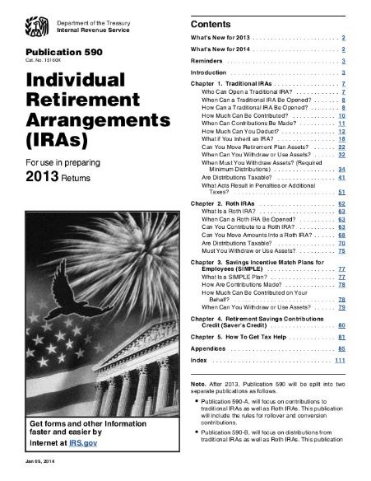
Origins of the IRA Publication 590
What is an IRA?
What does the IRS say?
“This publication discusses contributions to individual retirement arrangements (IRAs). An IRA is a personal savings plan that gives you tax advantages for setting aside money for retirement.”*
Contribution limits under age 50: $6,500; 50 and older: $7,500
Single individuals income ≥ $83,000 → Not eligible
Married (filing jointly) income ≥ $136,000 → Not eligible
*Source: IRS
Notes:
You’ll note in the top corner of Publication 590 that it is written for YOU, the public. It is a public publication. It's not written for tax experts. This document is easier to read and easier to understand than you might imagine and it's for you to read and understand so that you and your certified tax preparer can craft a return that pays the least amount of tax possible. That's what the IRS says. That's their goal. You shouldn't pay more than you have to. You should pay what you owe, but you shouldn't pay more. This is the publication. This is what it looks like.
[CLICK] “This publication discusses contributions to Individual Retirement Arrangements (IRAs). An IRA is a personal savings account that gives you tax advantages…(or gives the IRS tax advantages)…for setting money aside for retirement.” How many of you knew that IRA didn’t stand for Individual Retirement Account but it was Individual Retirement Arrangement?
There are contribution limits and there are income limits for IRAs.
[CLICK] Contribution limits:
Under age 50 = $6,000
50 and older = $7,000
[CLICK] Income limits:
- Single individuals income ≥ $78,000 → Not eligible
- Married (filing jointly) income ≥ $129,000 → Not eligible
From the IRS website:
Taxpayers can deduct contributions to a traditional IRA if they meet certain conditions. If during the year either the taxpayer or their spouse was covered by a retirement plan at work, the deduction may be reduced, or phased out, until it is eliminated, depending on filing status and income. (If neither the taxpayer nor their spouse is covered by a retirement plan at work, the phase-outs of the deduction do not apply.) Here are the phase-out ranges for 2019:
For single taxpayers covered by a workplace retirement plan, the phase-out range is $68,000 to $78,000.
For married couples filing jointly, where the spouse making the IRA contribution is covered by a workplace retirement plan, the phase-out range is $109,000 to $129,000.
For an IRA contributor who is not covered by a workplace retirement plan and is married to someone who is covered, the deduction is phased out if the couple’s income is between $204,000 and $214,000.
For a married individual filing a separate return who is covered by a workplace retirement plan, the phase-out range is not subject to an annual cost-of-living adjustment and remains $0 to $10,000.
[CLICK]

Slide 71
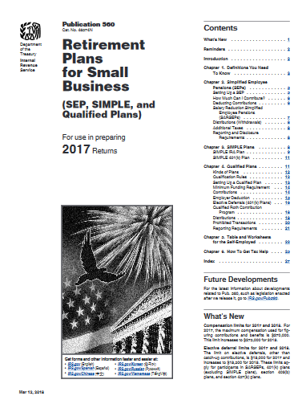
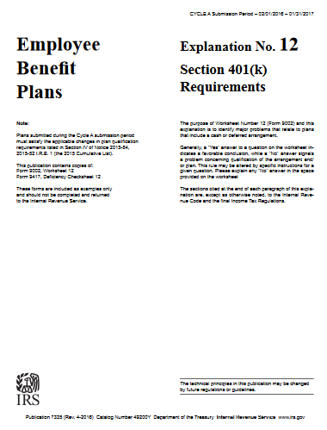
Origins of the 401k Section 401k
What is a 401k?
What does the IRS say?
“A 401(k) plan is a qualified plan that includes a feature allowing an employee to elect to have the employer contribute a portion of the employee’s wages to an individual account under the plan.
Elective salary deferrals are excluded from the employee’s taxable income (except for designated Roth deferrals).
Employers can contribute to employees’ accounts.
Distributions, including earnings, are includible in taxable income at retirement (except for qualified distributions of designated Roth accounts).”*
Depending on the type of plan:
Contribution limits under age 50: $22,500
50 and older catch up provisions $7,500
*Source: IRS
Notes:
One of the most popular tax-deferred savings accounts is the employer-sponsored 401k plan.
[CLICK] A 401(k) plan is a qualified plan that includes a feature allowing an employee to elect to have the employer contribute a portion of the employee’s wages to an individual account under the plan.
[CLICK] Elective salary deferrals are excluded from the employee’s taxable income (except for designated Roth deferrals).
[CLICK] Employers can contribute to employees’ accounts.
[CLICK] Distributions, including earnings, are includible in taxable income at retirement (except for qualified distributions of designated Roth accounts).”*
Two annual limits apply to contributions: A limit on employee elective deferrals; and
[CLICK] An overall limit on contributions to a participant’s plan account (including the total of all employer contributions, employee elective deferrals (but not catch-up contributions) and any forfeiture allocations).
Deferral limits for 401(k) plans
The limit on employee elective deferrals (for traditional and safe harbor plans) is $20,500 in 2022.
The $20,500 amount may be increased in future years for cost-of-living adjustments.
Generally, you aggregate all elective deferrals you made to all plans in which you participate to determine if you have exceeded these limits. If a plan participant’s elective deferrals are more than the annual limit, find out how you can correct this plan mistake.
Deferral limits for a SIMPLE 401(k) plan
The limit on employee elective deferrals to a SIMPLE 401(k) plan is $14,000 in 2022.
This amount may be increased in future years for cost-of-living adjustments.
Plan-based restrictions on elective deferrals
These restrictions may further reduce the maximum allowable elective deferrals. Your plan's terms may impose a lower limit on elective deferrals
If you are a manager, owner, or highly compensated employee, your plan might need to limit your elective deferrals to pass nondiscrimination tests.
Catch-up contributions for those age 50 and over
If permitted by the 401(k) plan, participants who are age 50 or over at the end of the calendar year can also make catch-up contributions.
The additional elective deferrals you may contribute is
- $6,500 in 2022 to traditional and safe harbor 401(k) plans - $3,000 in 2022 to SIMPLE 401(k) plans
These amounts may be increased in future years for cost-of-living adjustments
You don’t need to be “behind” in your plan contributions in order to be eligible to make these additional elective deferrals.
[CLICK]

Slide 72
How does an IRA/401k plan work?
Money is invested on a pre-tax basis
Pre-tax: Funds are deducted from your paycheck and are not included in your taxable income.
Ex: If your paycheck is $1,500 and you contribute $200 to your IRA/401k, $200 will go into your IRA/401k account, and the remaining $1,300 is taxed.*
You are essentially deferring the amount of income tax you need to pay and are deferring the tax calculation.
Withdrawals are taxed at an ordinary income rate
Source: IRS
*This information is intended for illustrative purposes only and is not guaranteed. Figures used are considered to be true, accurate and reliable, but are not guaranteed.
Notes:
How does an IRA/401k plan work?
[CLICK] So, number one, money is distributed on a pre-tax basis. Funds are deducted from your paycheck and are not included in your taxable income. Would you rather pay taxes on $1,000 right now and never pay taxes on that money again ever no matter how much it grows, or would you rather not pay taxes on the $1,000 now, wait till it's $10,000 and pay the taxes then?
Great, how many of you are doing that, paying taxes now? Why not? You just said that you want to do it this way, you just said that this makes sense, you just said mathematically that that's what you would do and yet you're not doing it, why not? Interesting question, right?
[CLICK] Example: If your paycheck is $1,500 and you contribute $200 to your IRA/401k, $200 will go into your IRA/401k account and you'll pay taxes on the remaining $1,300.
We're going to put $200 in the IRA/401k plan account. Are we ever going to have to pay taxes on that? Yes. So, it's not tax-free. We're choosing to pay taxes on it later when it's $4,000 or whatever the growth is going to be.
[CLICK] You're essentially deferring the amount of income tax you need to pay right now, not forever, just right now and you're deferring the tax calculation.
So again, withdrawals are taxed at the ordinary income rate.
[CLICK] Is there any such thing as a long-term capital gains tax treatment in an IRA/401k? There is not. You're going to pay the highest possible taxes according to your specific situation on any money that you take out of an IRA/401k. It doesn't matter how long you own the stock or mutual fund inside your IRA/401k.
[CLICK]

Slide 73
Origins of the Roth IRA Taxpayer Relief Act of 1997
Chief legislative sponsor, Senator William Roth of Delaware
Reduced tax rates and offered new tax credits for taxpayers
Tax exclusion from the sale of a personal residence
Tax relief for education savings & retirement accounts
Establishment of Roth IRAs
Contribution limits under age 50: $6,500; 50 and older: $7,500
Single individuals income ≥ Income $153,000 → Not eligible
Married (filing jointly) income ≥ Income $228,000 → Not eligible
Source: Investopedia
Notes:
The Taxpayer Relief Act of 1997
How many people know that this tax law, this taxpayer relief act, exists? Can anybody tell me what the form of relief was in Congress passing this tax act?
Question, what does Roth mean, where does it come from?
[CLICK] Answer: Senator Roth of Delaware, that's his name. He named it after himself.
[CLICK] It reduced tax rates and offered new tax credits for taxpayers, like a tax exclusion from the sale of a personal residence. Wow. That was a big deal. “Imagine making $250,000 and not having to pay taxes on it. That’s the generous tax break – the home sale exclusion - homeowners are entitled to when they sell their primary residence for a gain after having lived in the home for at least two of the five years immediately preceding the sale. Couples can shelter $500,000. But there’s a way to shelter even more - if you keep good records of home improvement projects which add to your house’s cost basis.
[CLICK] Tax relief-- relieved from paying taxes, there’s also a relief for educational savings and retirement accounts. Does anybody tonight have one of those?
[CLICK] Establishment of a Roth IRA: Of the thousands of myths, misconceptions, misunderstandings about Roths and Roth conversions, this is one of them. A lot of people I talk to who are very wealthy say, “I can't do a conversion”. Really? Why not? Because I'm too old. Is that true? Absolutely not.
A lot of people say, “I can't put money in a Roth. I can't convert because I make too much money”. Is that accurate? No, of course not. Not at all.
[CLICK] Contribution limits. Once again, there's a difference between how much money you can put in a contributory Roth IRA and how much money you can convert. Those are not the same. Those are very different and we're going to be talking more about the benefits of a conversion strategy.
As for the contributory Roth IRA the limits for 2022, they’re on the bottom of the screen.
Contribution limits
under age 50 = $6,000
50 and older = $7,000
Single individuals income ≥ Income $144,000 → Not eligible
Married (filing jointly) income ≥ Income $214,000 → Not eligible
On the IRS website there is a table
This table shows whether your contribution to a Roth IRA is affected by the amount of your modified AGI as computed for Roth IRA purpose.
If your filing status is... And your modified AGI is... Then you can contribute... married filing jointly or qualifying widow(er) < $204,000
up to the limit
> $204,000 but < $214,000
a reduced amount
> $214,000
zero
married filing separately and you lived with your spouse at any time during the year < $10,000
a reduced amount
> $10,000
zero
single, head of household, or married filing separately and you did not live with your spouse at any time during the year < $129,000
up to the limit
> $129,000 but < $144,000
a reduced amount
> $144,000
zero
Amount of your reduced Roth IRA contribution
If the amount you can contribute must be reduced, figure your reduced contribution limit as follows.
Start with your modified AGI.
Subtract from the amount in (1):
$204,000 if filing a joint return or qualifying widow(er),
$-0- if married filing a separate return, and you lived with your spouse at any time during the year, or
$129,000 for all other individuals.
Divide the result in (2) by $15,000 ($10,000 if filing a joint return, qualifying widow(er), or married filing a separate return and you lived with your spouse at any time during the year).
Multiply the maximum contribution limit (before reduction by this adjustment and before reduction for any contributions to traditional IRAs) by the result in (3).
Subtract the result in (4) from the maximum contribution limit before this reduction. The result is your reduced contribution limit.
See Publication 590-A, Contributions to Individual Retirement Accounts (IRAs), for a worksheet to figure your reduced contribution.
REMEMBER THE CONTRIBUTIONS MADE TO A ROTH IRA ARE DONE WITH AFTER TAX DOLLARS – meaning you have already paid taxes on these dollars (the contributions are not writes-offs) That is also why you pay the taxes upfront when you convert an IRA to a Roth. The government will always find a way to get a piece your hard-earned money!
[CLICK]

Slide 74
How does a Roth work?
Contributions are NOT tax deductible.
Post-tax: Funds are deducted from your paycheck and are included in your taxable income.
Ex: If you receive a $1,500 paycheck, the entire amount will be taxed, and any contributions made to a ROTH would be on a post-tax basis, and potentially grow tax deferred and distributions would potentially be tax free.*
Withdrawals are tax-free, can be done at anytime after you are 59 ½.
Five year rule: distributions stipulates that 5 years must have passed since the tax year of your first Roth IRA contribution before you can withdraw the earnings in the account tax-free.
Source: IRS
*This information is intended for illustrative purposes only and is not guaranteed. Figures used are considered to be true, accurate and reliable, but are not guaranteed.
Notes:
How does a Roth work?
[CLICK] First, you don't get to write the contribution off on your tax return. Let's go back to the $1,500 IRA example. When you put money in the Roth, the $1,500, you don't get to deduct it now, but you never pay taxes on it again. Why? Because you've settled that tax bill. It's over. It doesn't matter how much it grows. But remember, they're not deductible right now.
Post tax: funds are deducted from your paycheck, and they're included in your taxable income, so you're choosing to pay the tax now at a smaller rate on a smaller amount of money at a rate that's known to you rather than an unknown tax rate in the future.
Example: Here we are with our $1500 paycheck. The entire thing gets taxed. You have to pay tax on the $200 that you put in.
The Roth account would grow tax-deferred, and distributions would then potentially be tax free. That's the best. All the principle along with any gains are tax free after five tax years go by.
[CLICK] Tax free withdrawals, of course, can be taken at any time after you're 59 and a half.
[CLICK] Again, is there a five-year rule. You put the money in now, you pay the taxes on it now, and it's tax-free after five tax years.
[CLICK]

Slide 75
LIFE INSURANCE TYPES
TERM
Death benefit only and sold for a specific period of time like 10 years
WHOLE LIFE
Permanent insurance with death benefit and builds up a tax-deferred cash value over the life of the policy
UNIVERSAL LIFE
Permanent insurance with flexible premiums and the option to adjust the death benefit over time and has a cash value component
INDEXED UNIVERSAL LIFE
Permanent life insurance with a death benefit and a cash value. The cash value grows by tracking a stock market index.

Slide 76
Tax Treatment of Permanent Life Insurance Section 7702
Life Insurance with Cash Value – Whole Life, Universal Life, IUL & VUL
Section 7702: Defines what is considered a life insurance contract for federal tax purposes
Created in order to limit the tax benefits given to life insurance policies
Imposes limitations on premiums and benefits relative to death benefits
Notes:
Does anybody have life insurance, anybody like life insurance?
[CLICK] Has anybody heard of an IUL or VUL? An Indexed Universal Life or Variable Insurance contract? Ok, we will discuss that shortly.
[CLICK] Section 7702 defines what is considered a life insurance contract for federal tax purposes.
Does the IRS have any concern with the fact that people are taking hundreds of thousands of dollars out and not paying any taxes on it at all? Does that pop up on their radar screen? It absolutely does.
[CLICK] Section 7702 was created in order to limit the tax benefits given to life insurance companies. Wow. Think about this. Policies are so important, so many people have them, and there's so much potential tax-free income in them, that the IRS had to set limits. They had to set up corridors and hallways inside a life insurance contract to limit how much money you could put in.
[CLICK] And then again, the IRS imposes limitations on premiums and benefits relative to death benefits.
[CLICK]

Slide 77
How does Permanent Life Insurance work?
Contributions are NOT tax deductible
Gives the policy holder the option to allocate cash value amounts to either a fixed account, an equity index account, a sub account (similar to a mutual Fund) or in the case of whole life the Insurance determines the rate, and the outcome is predetermined and with Universal Life the cash value grows based on current interest rates
No taxes are due during accumulation phase when cash value builds
Death Benefits are typically tax-free
Potential tax-free withdrawals in the form of policy loans and return of principal
Contribution Limits: None
Notes:
So how does permanent life insurance work?
[CLICK] Contributions are not tax deductible. You can't put money, pretax money, IRA money, retirement money, into a life insurance policy.
[CLICK] These policies give the policy holder options depending on the type of permanent insurance they select.
With an IUL, you can allocate cash value amounts to either a fixed account or an equity index account. With the index option, you get market link gains without market-based risk. Again, all that means is it goes up when the market goes up, it doesn't go down if the market goes down.
With a VUL, you have choices of sub accounts (similar to a mutual Fund, with the same up and downs).
In the case of whole life, the Insurance company determines the rate, and the outcome is predetermined.
With Universal Life, the cash value grows based on current interest rates.
[CLICK] No taxes are due while it's growing.
[CLICK] Death benefits are typically tax free.
[CLICK] And again, potential tax-free withdrawals in the form of policy loans and return of principle.
[CLICK] As for contribution limits, there are none.
[CLICK]

Slide 78
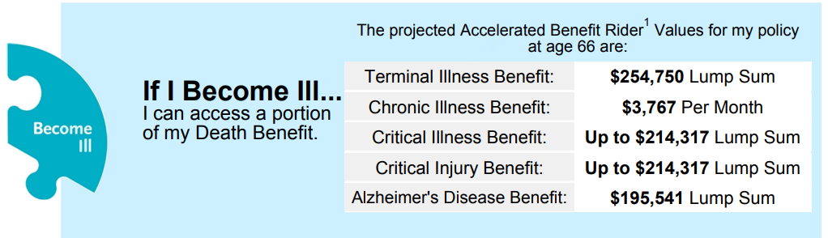
Special Uses of Indexed Universal Life
COLLEGE SAVINGS PLAN – AVOID COLLEGE DEBT
TAX FREE DOWN PAYMENT ON A HOUSE
LIVING BENEFITS
TAX FREE RETIREMENT INCOME
SPECIALIZED INCOME REQUIREMENTS
Notes:
So how does permanent life insurance work?
[CLICK] Contributions are not tax deductible. You can't put money, pretax money, IRA money, retirement money, into a life insurance policy.
[CLICK] These policies give the policy holder options depending on the type of permanent insurance they select.
With an IUL, you can allocate cash value amounts to either a fixed account or an equity index account. With the index option, you get market link gains without market-based risk. Again, all that means is it goes up when the market goes up, it doesn't go down if the market goes down.
With a VUL, you have choices of sub accounts (similar to a mutual Fund, with the same up and downs).
In the case of whole life, the Insurance company determines the rate, and the outcome is predetermined.
With Universal Life, the cash value grows based on current interest rates.
[CLICK] No taxes are due while it's growing.
[CLICK] Death benefits are typically tax free.
[CLICK] And again, potential tax-free withdrawals in the form of policy loans and return of principle.
[CLICK] As for contribution limits, there are none.
[CLICK]

Slide 79
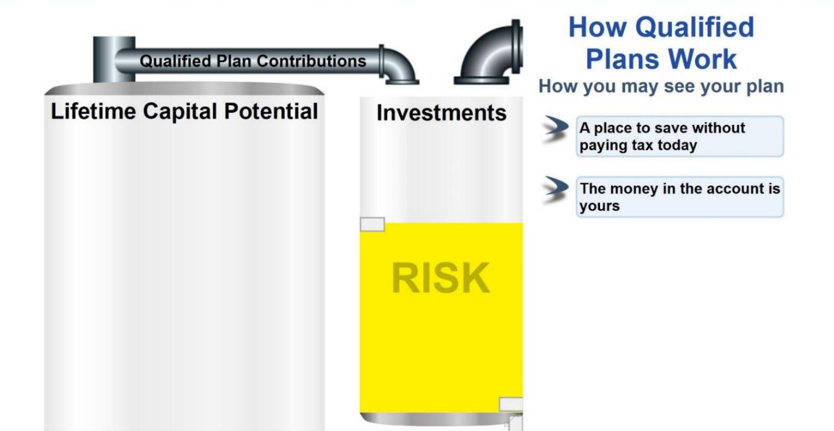
How we see our IRAs & 401(k)…
Source: Circle of Wealth
Notes:
Sometimes a visual helps to understand taxes.
On the left, the big tank is filled up by your income, except for those dollars siphoned off by Qualified Plan Contributions. Those contributions into your IRAs, 401ks, 403bs and the like are put in the investment tank on the right.
We always see the best picture when it comes to our “stuff”, right? So, the yellow is your money, right? Your investments are growing each year, right?
Well, not so fast… you have a partner in this account. It’s sort of like a joint account. I know it doesn’t have your spouse’s name on it or your children’s name, BUT you do have a partner…..
[CLICK]

Slide 80
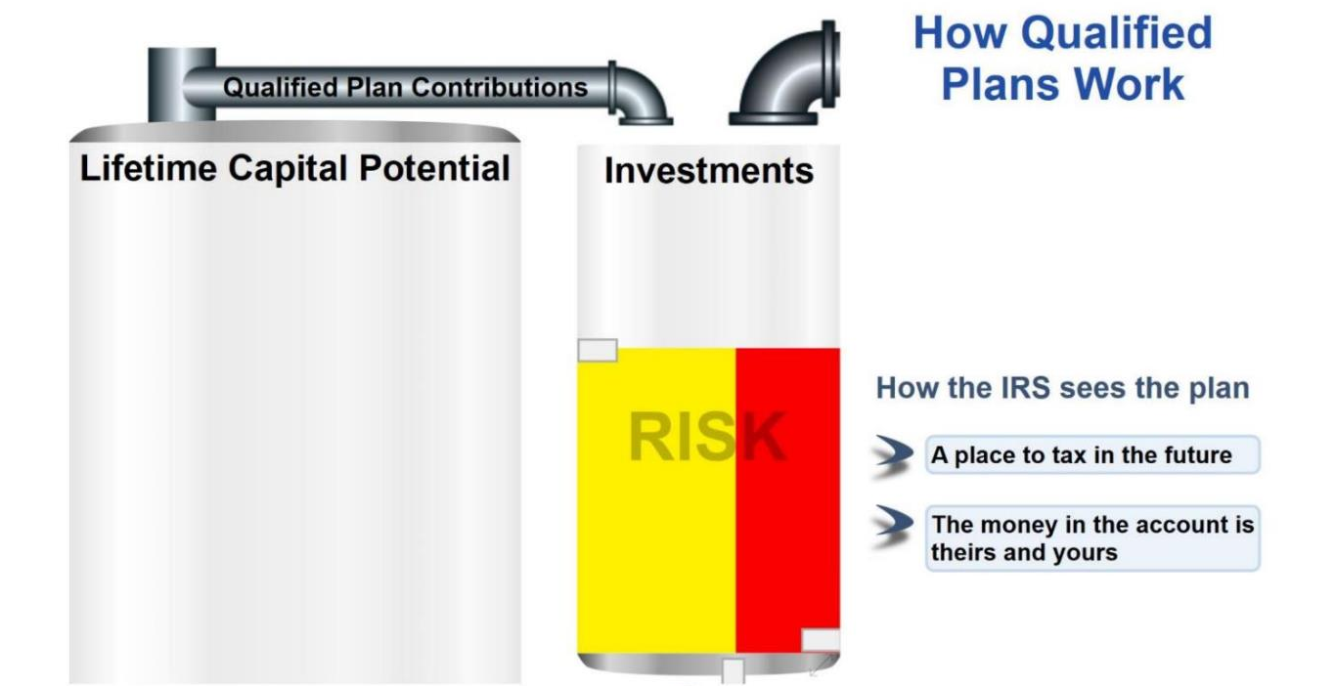
How the IRS sees our IRAs & 401(k)…
Source: Circle of Wealth
Notes:
Your partner is in red, the IRS. This is how they see a qualified account. A place to tax you in the future, including all the growth. The IRS loaned you the money. It was essentially a loan. The money that you chose not to pay taxes on, the IRS loaned you that money so you could pay it back later. That's how the whole system operates. So, the red money shows us the tax in the future. That money in the account is theirs, it's not yours. That's the way the IRS sees it.
[CLICK]

Slide 81
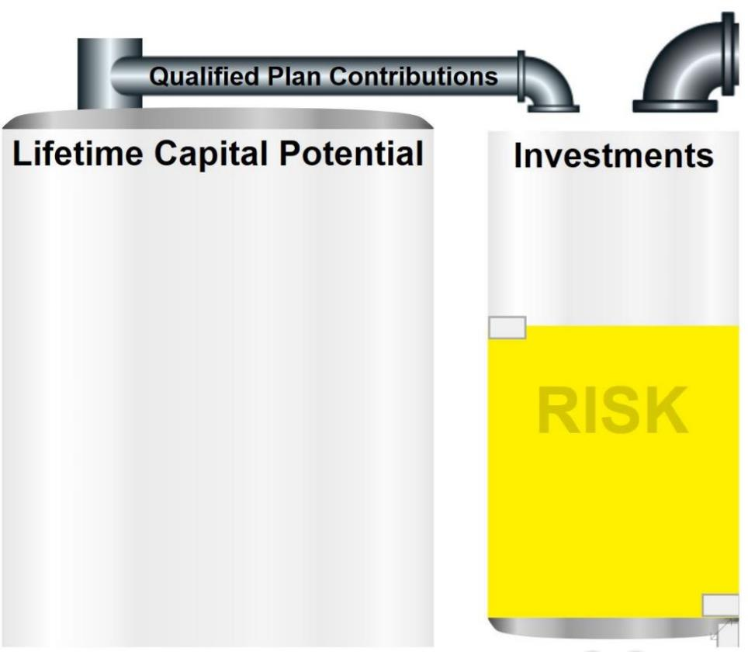
Roth/PLI
Source: Circle of Wealth
Notes:
However, if you use a Roth and Permanent Life Insurance (PLI) to save in, all of that yellow money in the investment tank is potentially tax-free, meaning it belongs to you and your heirs, not the government!
[CLICK]

Slide 82
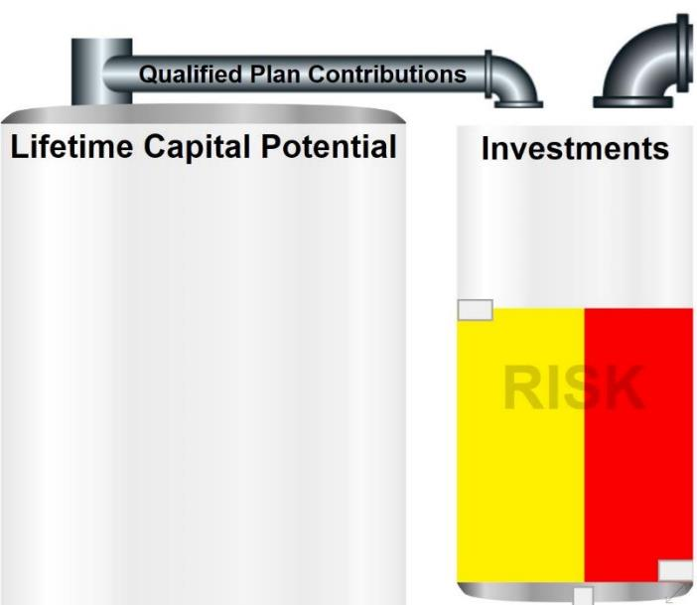
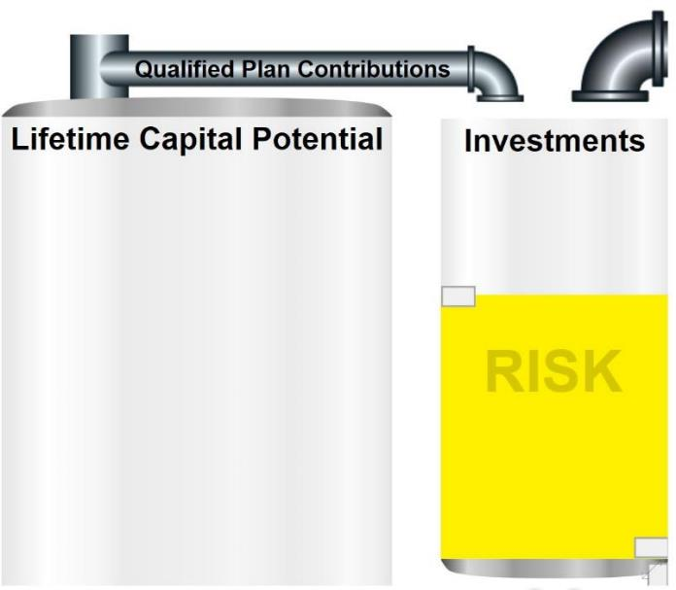
Tax Deferred
vs.
Tax Advantaged
IRA (Tax Deferred)
Roth/PLI (Tax Advantaged)
Source: Circle of Wealth
Notes:
Tax deferred, which is what most of everybody in the room is doing and is familiar with, includes a big chunk of money that does not belong to you.
So, understanding the difference between tax deferred and tax advantaged or tax-free is really important when you’re looking at income projections for retirement. If 20-30% of your income has to be used for taxes and you didn’t account for that, its easy to see how that can disrupt your plan.
Most smart money people on Wall Street believe that taxes are “on sale” right now. By a show of hands, are we all familiar with the debt clock? That meter that spins worse than the one on your house that the power company owns! Taxes have never really been this low before and, given where the National Debt sits, how will the government pay on that debt – let alone pay it off? Taxes… that is the only revenue source the government has. So, paying taxes now instead of guessing what they will be in the future makes a lot of sense. I have often said its easier to plan for taxes than pay taxes.
[CLICK]

Slide 83


ROTH
Section 7702

Slide 84
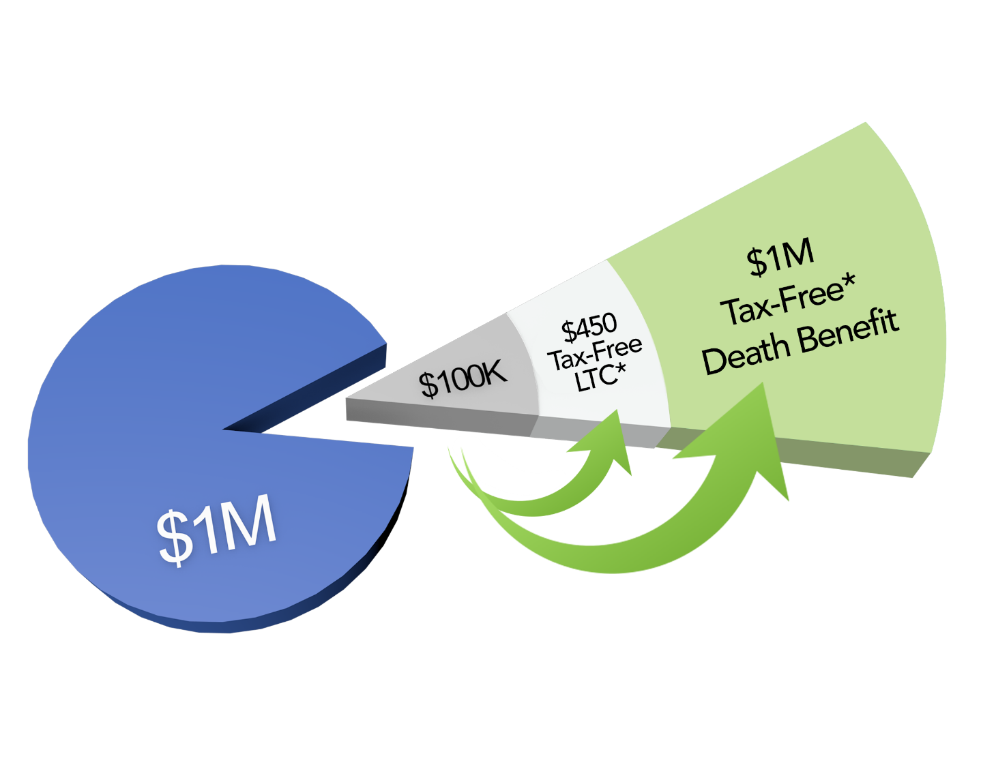
Using An IUL For Multiple Uses

Slide 85
LET’S TALK ABOUT SOCIAL SECURITY
Men receive an average payment of $1,723.82 per month.
Women receive an average of $1,388.08.
Most people receiving Social Security receive $800 to $1900 per month.
Social Security alone does not provide enough income.

Slide 86
ANNUITY TYPES
FIXED
Guarantees payment of a set amount of interest per year for the term of the agreement.
INDEXED
Pays an interest rate based on the performance of a specified market index, such as the S&P 500.
VARIABLE
Fluctuates with the returns on the mutual funds it is invested in. Its value can go up (or down).
INCOME
Provides guaranteed monthly income payments for the life of the contract, regardless of market conditions.

Slide 87

Remember the 8 Common Places to Put Your Money?
Potential
Return
Stocks & Corp. Bonds
Mutual Funds
&
ETFs
Variable
Annuities
Government
Bonds
Savings
Fixed
Annuities
Indexed
Annuities
Cash
CD’s
DOWNSIDE PROTECTION
Potential
Loss
This is conceptual only and should not be considered investment advice
Notes:
Remember the 8 common places to put your money in retirement?
The safe wealth plan approach focuses on the right side of this conceptual graphic to provide
[CLICK]
Downside protection so your retirement assets aren’t subjected to market losses that can take years to recover from increasing your and increasing significantly your longevity risk

Slide 88
The Real Value of Downside Protection
Public Market Investment
Indexed Annuity
Initial Balance
$100,000
$100,000
Market Drops 30%
-$30,000
$0
New Account Balance
$70,000
$100,000
Market Goes Up 30%
$21,000
$15,000
New Account Balance
$91,000
$115,000
Let’s assume your indexed annuity has a 50% participation rate (50% of 30% = 15%)
Notes:
Let’s look at the real value of this downside protection that an indexed annuity can provide you. You might be surprised at how very important this is.
In this example a retiree, let’s call her Jane, has $100,000 in her account. In one scenario her $100,000 is invested in the stock market. In the second example, her funds are used to purchase an indexed annuity that is tied to the S&P500 index with a 50% participation rate.
Now, I should explain what the participation rate is. Indexed annuities usually have a participation rate as part of their contract terms. In this example the participation rate is 50%, so if the S&P500 goes up $10 dollars, her account will be credits with $5. Simple right. But remember, if the S&P 500 drops 10%, her account will not go down at all due to the market loss.
Ok, so in this example, the stock market drops 30% in year 1. Janes stock market account drops by 30% or $30,000.
Janes indexed annuity account doesn’t drop at all because of her downside protection. Her indexed annuity still has an account value of $100,000.
So after this stock market drop, Janes account has $70,000 left in the stock portfolio account, and still has $100,000 in her indexed annuity account example.
But the markets always recover right! Well let’s see how this works.
In year 2 of our example, the market does in fact rebound and it goes up by 30%, the same amount it dropped the year before. So, her stock portfolio account goes up by 30% of her $70,000 balance or $21,000, giving her a balance of $91,000 at the end of year 2.
In the indexed annuity example, at the end of year two in which the market went up by 30%, Janes account is credited with $15,000. Can anyone answer why it is $15,000?
Correct, Jane’s indexed annuity has a participation rate of 50%, so her account is credits with 50% of the 30% market gain, or 15% equal to $15,000.
At the end of year two in which the market recovered all of its losses, Janes stock portfolio account is workth $91,000, but her indexed annuity account is worth $115,000, a 28% difference. This is the power of downside protection.

Slide 89
The Real Value of Downside Protection
Public Market Investment
Indexed Annuity
What Does it take to get your money back?
43% to get back to $100,000 balance
(if you include fees it takes 46-47% to get back to $100,000)
Initial Balance
$100,000
$100,000
Market Drops 30%
-$30,000
$0
New Account Balance
$70,000
$100,000
Market Goes Up 43%
$30,100
$21,500
New Account Balance
$100,100
$121,500
Again, let’s assume your indexed annuity has a 50% participation rate (50% of 43% = 21.5%)
Notes:
Now let’s look at the same example with Jane’s account, but let’s see what it takes to get Jane back to even after suffering the 30% market drop.
These are the same scenarios where Jane has $100,000 invested in stocks, or $100,000 invested in an indexed annuity with a 50% participation rate.
So, after the 30% loss, Janes stock account has a $70,000 value and her indexed annuity is still at $100,000.
Now to get back to even after a 30% loss, Jane needs to make $30,000 in year two. $30,000 divided by her $70,000 stock account value is 43%. So Jane needs the market to go up by 43% just to get back to even after 30% loss.
What happens to her indexed annuity if this extraordinary gain does in fact happen? Remember Jane has a 50% participation rate, so her account is credited with 50% of the 43% gain, or $21,500.
At the end of year two in this example, Jane did get her stock account back to even with where she started at $100,000. But the indexed annuity account grew by 21% to $121,500.
Now the real question is? In which of these two scenarios do you think Jane had a better peace of mind over these two turbulent years?
Part of building the Safe Wealth Plan is not jut financial protection, its also about Peace of Mind.

Slide 90
The Problem with the Systematic Approach
Systematic Approach
Year 3 - 5)
Advsisors often recommend that a good systematic approach to retirement is a 4% withdrawal rate annually.
Initial Balance
$500,000
$442,368
4% withdrawal (year 1)
-$20,000
(3) -$17,695
New Account Balance
$480,000
$424,673
Market drops 20%
-$96,000
(4) -$16,987
New Account Balance
4% withdrawal (year 2)
$384,000
-$15,360
$368,640
$407,686
(12% $48,922
New Account Balance
Market Gains 20% +$73,728
$456,608
(5) -$18,264
Notes:
Now let’s look at the same example with Jane’s account, but let’s see what it takes to get Jane back to even after suffering the 30% market drop.
These are the same scenarios where Jane has $100,000 invested in stocks, or $100,000 invested in an indexed annuity with a 50% participation rate.
So, after the 30% loss, Janes stock account has a $70,000 value and her indexed annuity is still at $100,000.
Now to get back to even after a 30% loss, Jane needs to make $30,000 in year two. $30,000 divided by her $70,000 stock account value is 43%. So Jane needs the market to go up by 43% just to get back to even after 30% loss.
What happens to her indexed annuity if this extraordinary gain does in fact happen? Remember Jane has a 50% participation rate, so her account is credited with 50% of the 43% gain, or $21,500.
At the end of year two in this example, Jane did get her stock account back to even with where she started at $100,000. But the indexed annuity account grew by 21% to $121,500.
Now the real question is? In which of these two scenarios do you think Jane had a better peace of mind over these two turbulent years?
Part of building the Safe Wealth Plan is not jut financial protection, its also about Peace of Mind.

Slide 91
Safe Wealth Plan Approach
Initial investment = $500,000
14% annual roll up bonus for 7 years = $490,000
Total Income Benefit Base at Year 7 = $990,000
Guaranteed Annual Income for life = $ 58,113
Downside Protection guarantees no risk of loss from market downturns.
Income is guaranteed from year 7 for life.
Notice how this plan offers a more stable and guaranteed income for life. It has no danger of running out of money.
Represents $500,000 invested at age 60 with income starting at Age 67.
Notes:
Now let’s look at the same example with Jane’s account, but let’s see what it takes to get Jane back to even after suffering the 30% market drop.
These are the same scenarios where Jane has $100,000 invested in stocks, or $100,000 invested in an indexed annuity with a 50% participation rate.
So, after the 30% loss, Janes stock account has a $70,000 value and her indexed annuity is still at $100,000.
Now to get back to even after a 30% loss, Jane needs to make $30,000 in year two. $30,000 divided by her $70,000 stock account value is 43%. So Jane needs the market to go up by 43% just to get back to even after 30% loss.
What happens to her indexed annuity if this extraordinary gain does in fact happen? Remember Jane has a 50% participation rate, so her account is credited with 50% of the 43% gain, or $21,500.
At the end of year two in this example, Jane did get her stock account back to even with where she started at $100,000. But the indexed annuity account grew by 21% to $121,500.
Now the real question is? In which of these two scenarios do you think Jane had a better peace of mind over these two turbulent years?
Part of building the Safe Wealth Plan is not jut financial protection, its also about Peace of Mind.

Slide 92
LET’S BRIEFLY DISCUSS WHAT IS DEVELOPING!
DIGITAL CURRENCY
Digital currency is a form of currency that is available only in digital or electronic form. It is also called digital money, electronic money, electronic currency, or cybercash.
Remember it is not law yet!
Don’t forget the metric system scare a few years ago!
Remember that our money is not backed by anything of value.
Know that many SS recipients already get money on their debit card every month.
Digital currencies are currencies that are only accessible with computers or mobile phones .
Typical digital currencies do not require intermediaries and are often the cheapest method for trading currencies.
All cryptocurrencies are digital currencies, but not all digital currencies are cryptocurrencies.
Some of the advantages of digital currencies are that they enable seamless transfer of value and can make transaction costs cheaper.
Some of the disadvantages of digital currencies are that they can be volatile to trade and are susceptible to hacks.

Slide 93
LET’S BREIFLY DISCUSS WHAT IS DEVELOPING!
NEW TAX CODE IN 2026
Present tax code expires December 31, 2025
National Debt will soon top 33,000,000,000,000 (trillion).
Social Security is running a deficit and is scheduled to be out of money in 2035.
C- on infrastructure is requiring repairs and new developments
Corporate taxes will likely increase.
The Budget Reconciliation Process now requires only a simple majority to change debt limits and increase spending.
tax cuts are set to expire at the end of 2025 and 2026 tax rates and tax brackets will be higher for most households. Without further legislation, the TCJA tax cut for households is set to expire at the end of 2025. Households could see tax rates revert to 2017 levels in 2026. For many people, their tax burden will rise

Slide 94
LET’S BRIEFLY DISCUSS WHAT IS DEVELOPING!
STOCK MARKET VOLATILITY
401(k) plan participants have lost about $1.4 trillion from their accounts since the end of 2021.
People with IRAs — most of which are 401(k) rollovers — have lost $2 trillion this year.
A Bear market occurs every 56 months.
The current bear market has now been running for just over ten months.
This is longer than the average bear market at 9.6 months, but shorter than the longest ever which lasted a full 20 months back in 1973/74.
The probability of an economic recession looks to be growing, interest rates are on the up and inflation remains high. Even the real estate market has started to come off it's all time highs.
For investors, it might mean we’ve got a ways to go, which means looking for ways to protect your portfolio in the meantime.

Slide 95
LET’S BRIEFLY DISCUSS WHAT IS DEVELOPING!
RETIREMENT
Inflation requires more money in retirement.
Healthcare costs are rising.
Every day until 2030, 10,000 “Baby Boomers” will reach the age of 65.
Seven out of every 10 people will require long-term care.
Retirement planning should include determining time horizons, estimating expenses, calculating required after-tax returns, assessing risk tolerance , and doing estate planning.
Start planning for retirement as soon as you can to take advantage of the power of compounding.
Younger investors can take more risk with their investments, while investors closer to retirement should be more conservative.
It is very important to develop a Retirement Income Plan that including a good budget.

Slide 96
LET’S BRIEFLY DISCUSS WHAT IS DEVELOPING!
COLLEGE COSTS AND STUDENT LOANS
The average cost of attending a four-year college or university rose by 497% between 1985 and 2017.
Factors that contribute to this trend are growing demand for degrees, reduced state-level funding for public colleges, rising administrative expenses, and the use of federal student loans.
It is more important than ever to start preparing early and there are a number of things that you can do including investing funds in the right vehicles.
Choosing the right college to attend is very important.
Shortening the time in college. Some are taking 6 years to obtain a 4-year degree.
Students can now have an associate’s degree when they graduate high school in many areas.
Some students are far better off getting a skill or a technical degree. Find out what your child’s talent is. Let the child have a part in the decision.

Slide 97
FINAL STEPS
WHAT SHOULD I DO NOW?
WORK WITH A FINANCIAL COACH.
DEVELOP A “GET OUT OF DEBT” STRATEGY.
DEVELOP AND STICK TO A BUDGET.
BEGIN SAVING.
CHOOSE THE BEST INVESTMENT TOOL FOR YOU.

